Slide 1
Used Bike Price Prediction Model
R Software Project
By Sai Siddhanth & Sai Nithish

Slide 2
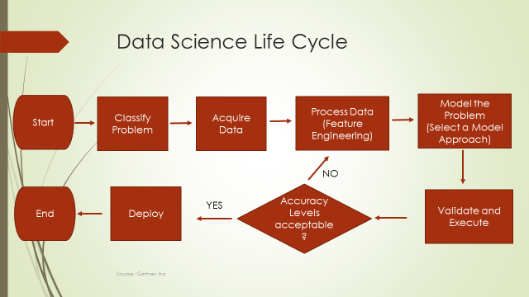

Slide 3
High Level Problem Statement
The aim to model a resale valuation for used bikes and predict the price of used bikes. This can be helpful while selling a used bike or buying a used bike.
Number of Records / Observations: 7857
Number of Features: 11
Target variable: Price

Slide 4
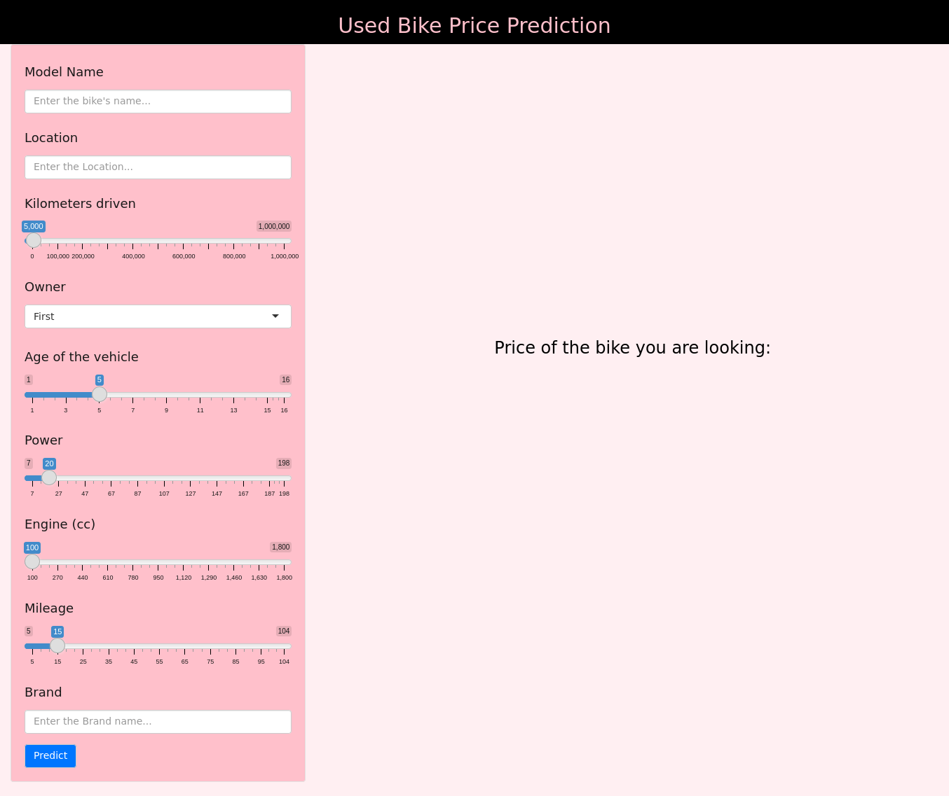
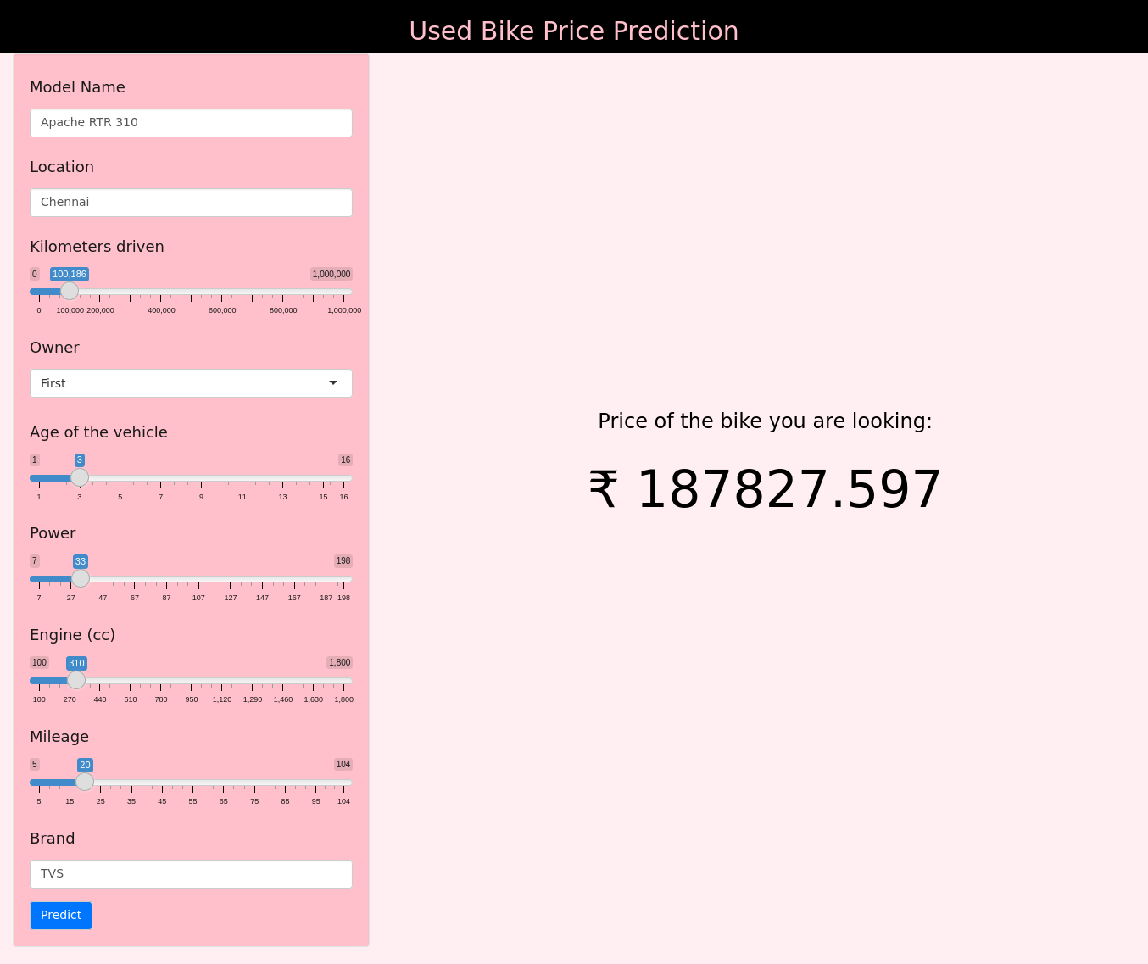
Model UI - Prediction Sample

Slide 5
Data features available
Categorical features available
Numerical features available
Kms_driven
Owner
Mileage
Power
Engine
Age
City_tier
Price
Brand
City

Slide 6
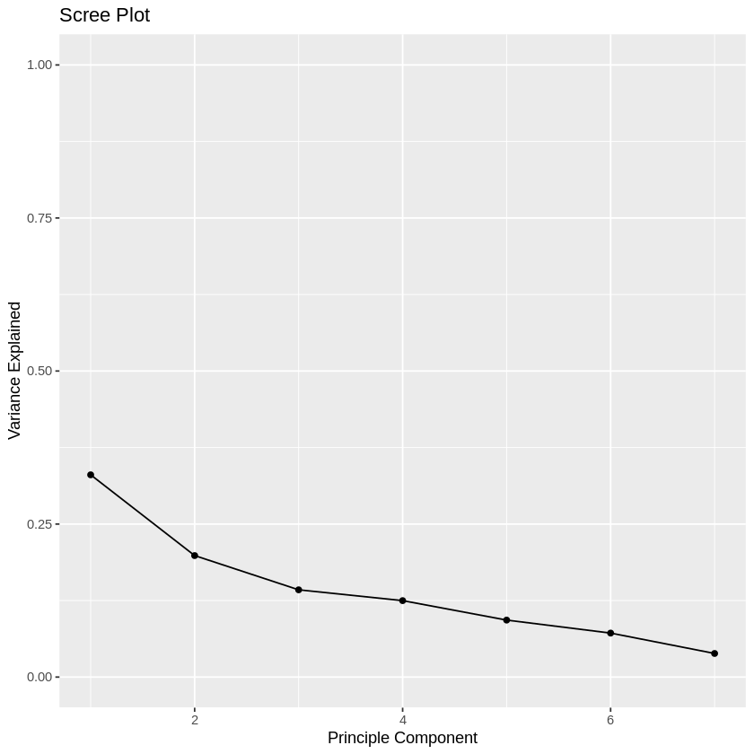
PCA Scree Plot

Slide 7
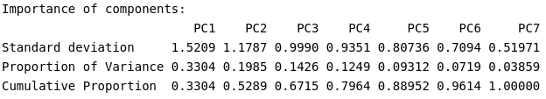
Proportion of Variance Explained

Slide 8
Features Recommended by Different Methods
Backward Elimination:
Kms_driven, Owner, Mileage, Power, Engine, Age, City_tier
Forward Substitution:
Kms_driven, Owner, Mileage, Power, Engine, Age, City_tier
Stepwise Regression:
Kms_driven, Owner, Mileage, Power, Engine, Age, City_tier
PCA:
Kms_driven, Owner, Mileage, Power, Engine, Age, City_tier

Slide 9
Final Feature Set Selected
Kms_driven
Owner
Mileage
Power
Engine
Age
City_tier
Price

Slide 10
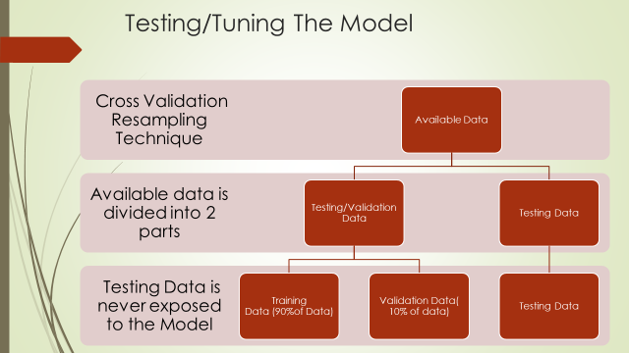
Model Performance Methodology

Slide 11


Model Performance - Validation Data vs Test Data
Train Data:
Validation Data:

